Slide 1
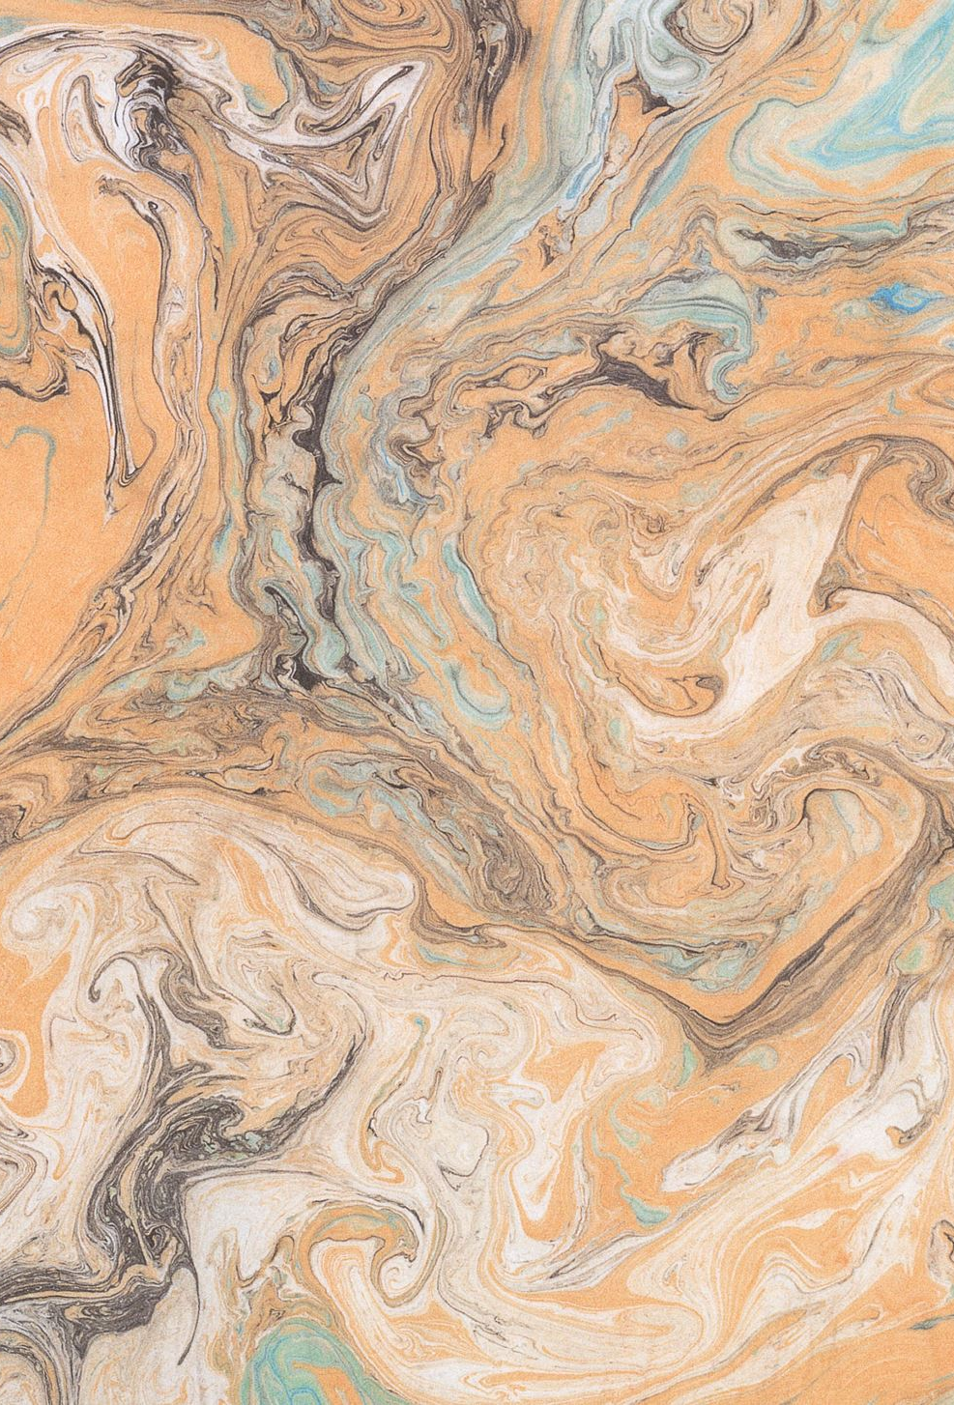

Plant phenology identification
Green Tech Solutions

Slide 2
Introduction
Objective:
Develop a robust machine learning model to classify the plant life stages of the Aloe Ferox (e.g., flower, bud).
Significance:
Aids in managing invasive plants and environmental monitoring.
This product saves time when identifying the different stages and removes human error from this identification.
Approach:
Utilized EfficientNetB0 for transfer learning, leveraging pre trained features for faster and more accurate model training.
Iterative model development and refinement to address challenges.

Slide 3
program Workflow
Image collection
Image organization
Image preprocessing
Model training
Model Integration into the UI
Deployment

Slide 4
Image collection
Process:
We sourced images from the URLs in the Aloe Ferox imagery database.
Downloaded and saved the images into a structured folder system.
Tools used:
Pandas: to read the URLs from the excel sheet.
Requests: to download said images.
TQDM: for progress tracking during downloads.

Slide 5
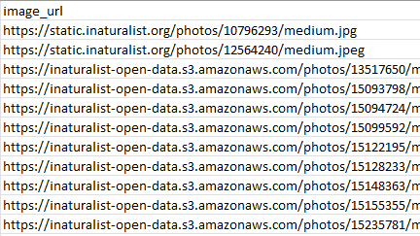

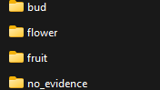
Image organization
Process:
As the images were downloaded, they got stored into different directories for training, validation and testing.
The images got split into 70% for training, 15% for validation and 15% for testing. This ensures balance across the categories to maintain model fairness.
Each directory has the four classification categories.
Tools used:
OS Module: to handle file system operations.
Shutil: to move the categories into the appropriate directories.
Python random library: for shuffling and splitting images.

Slide 6
Image preprocessing
Process:
Normalized pixel values to improve model performance.
Applied data augmentation techniques to increase dataset variety.
Tools used:
Tensorflow/Keras: to create datasets and apply preprocessing.
Data Augmentation layers: for flips, rotations, zoom, brightness and contrast adjustments.
Rescaling layer: to normalize pixel values for better model performance.

Slide 7
Model training
Process:
We fine tuned the EfficientNetB0 model with additional layers to better fit our needs.
We then trained the model on the prepared dataset, ensuring optimal performance through callbacks.
Tools used:
EfficientNetB0: pre-trained model leveraged for transfer learning.
AdamW Optimizer: for efficient gradient based optimization.
EarlyStopping callback: this stops training when no further improvement during training is observed.

Slide 8
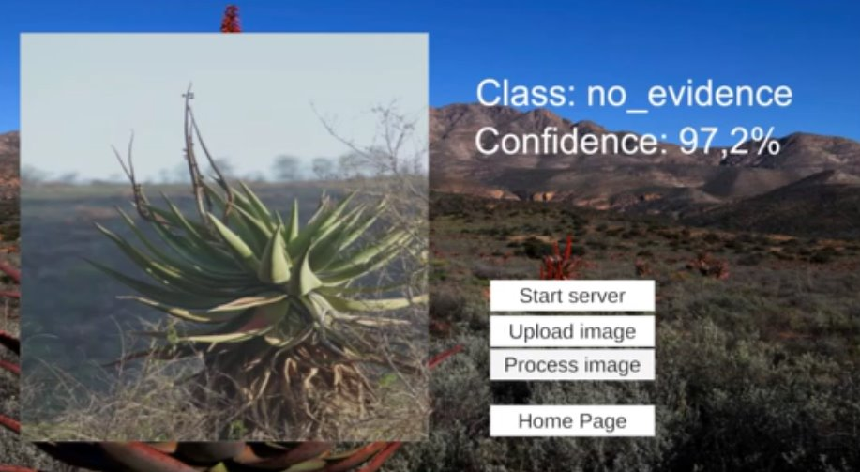
Model Integration Into the UI
Process:
We developed an API for the model using Fast to allow interaction with the UI.
The API takes images uploaded by the user, preprocesses it and makes a prediction based on the trained model.
Tools used:
Fast: for API development.
Tensorflow: for model serving.
PIL: for image processing.

Slide 9
Deployment
Process:
The API is deployed locally for now.
Created a user friendly UI.
Our UI communicates with the backend via the Fats endpoints.
Tools used:
Unity: for creating our UI

Slide 10
Future improvements
We would like to develop our code to be able to include the classification of various other plant species.
We would also like to add in a feedback function to allow users to send in complaints or tips for improvement.

Slide 11
Conclusion
Importance of this system:
This product speeds up the process of manual classification.
This will help researchers monitor plant growth stages and contribute to understanding the impact of climate change on plant life.
Achievements:
Iterative improvement from bad accuracy to good accuracy.
Balanced model complexity with dataset constraints.
What we learned:
Importance of refined augmentation techniques.
Iterative problem solving as a critical success factor.

